Slide 1
for loops.
Week 3 | Lecture 2 (3.2.1)
While waiting for class to start:
Download and open the Jupyter Notebook (.ipynb) for Lecture 3.2.1
You may also use this lecture’s JupyterHub link instead (although opening it locally is encouraged).
Upcoming:
Reflection 3 released Friday @ 11 AM
Lab 3 deadline this Friday @ 11 PM
PRA (Lab) on Friday @ 2PM this week (ONLINE)
Midterm - May 31 in lecture @ 9:10 AM

Slide 2
Today’s Content
Lecture 3.2.1
for loops
Lecture 3.2.2
for loops on indices, nested loops

Slide 3
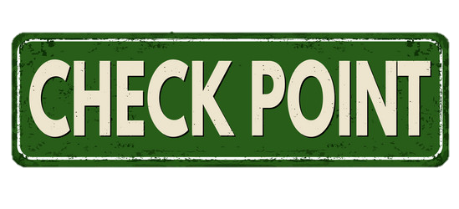
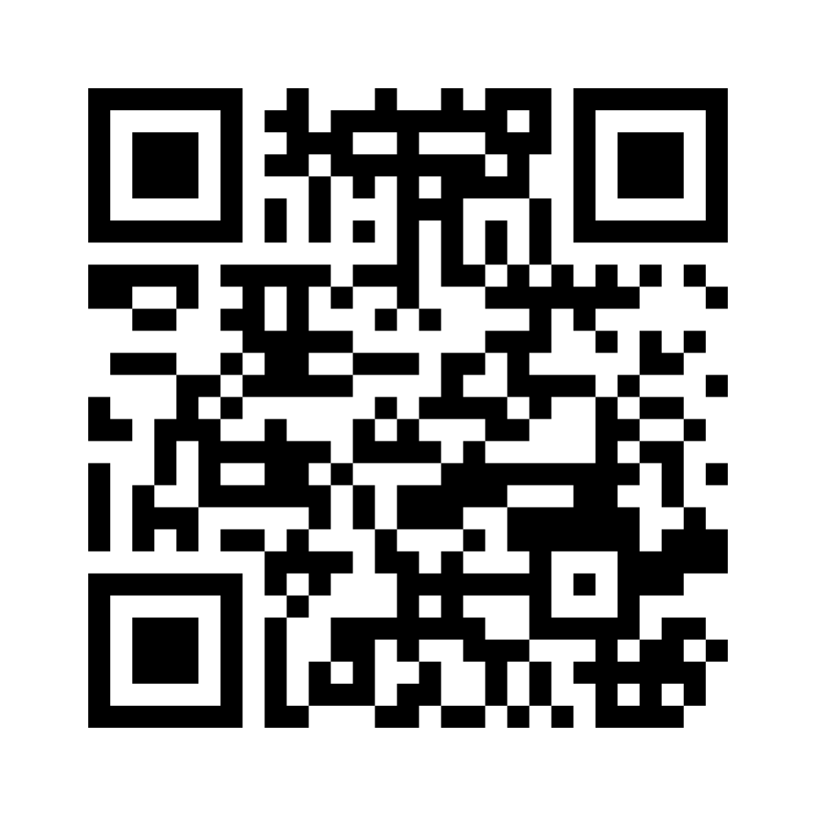
Mentimeter Checkpoint
Join at www.menti.com:
Code: 9493 9270
Link
https://www.menti.com/bldrkshx7mcz

Slide 4

Looping (Iterating)
List of Customers
Looping means repeating something over and over until a particular condition is satisfied.
Looping
Send Promotional Email
Email

Slide 5
Looping (Iterating)
List of Tweets
Looping means repeating something over and over until a particular condition is satisfied.
Looping
Does the Tweet contain #cleancode
Yes/No

Slide 6
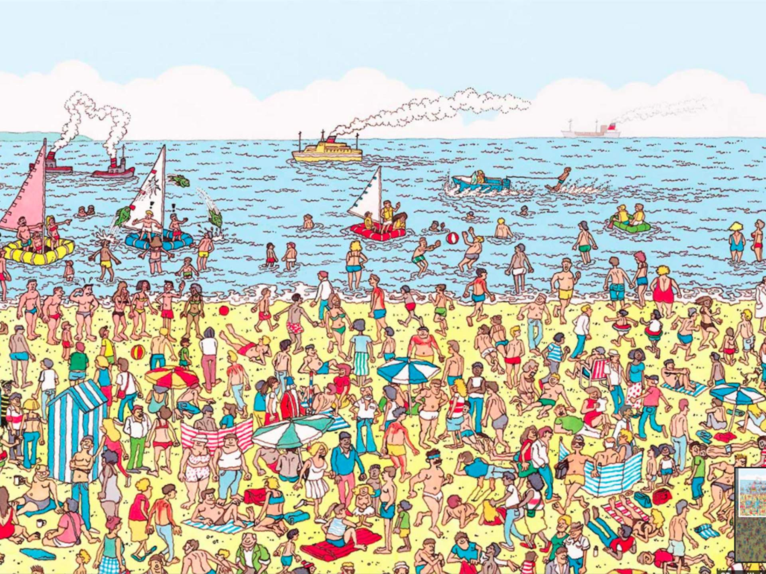
Looping (Iterating)
Looping means repeating something over and over until a particular condition is satisfied.
Check for Waldo
Looping
Yes/No

Slide 7
Looping (Iterating)
Looping means repeating something over and over until a particular condition is satisfied.
Check for Waldo
Looping
Yes/No

Slide 8
Looping (Iterating)
Looping means repeating something over and over until a particular condition is satisfied.
Check for Waldo
Looping
Yes/No

Slide 9
Looping (Iterating)
Looping means repeating something over and over until a particular condition is satisfied.
Check for Waldo
Looping
Yes/No

Slide 10
Looping (Iterating)
Looping means repeating something over and over until a particular condition is satisfied.
Check for Waldo
Looping
Yes/No

Slide 11
for loops
There are several ways to repeat a block of code.
We’ve already seen while loops and this week, we’ll discuss for loops.
Do Something = block of code we want to execute.
while expression:
do something.
for item in iterable:
do something.

Slide 12
for loops
name = ‘Sebastian’
for character in name:
print(character)
Output:
S
e
b
a
s
t
i
a
n
A for loop starts with the keyword for.

Slide 13
for loops
name = ‘Sebastian’
for character in name:
print(character)
for item1, item2 in iterable:
do something.
Next, we provide the name of one of more variables.
We have called the variable character, but you can call it whatever you like as long as it follows rules for naming a variable.

Slide 14
for loops
name = ‘Sebastian’
for character in name:
print(character)
Output:
S
e
b
a
s
t
i
a
n
Our variable character will be bound to each of the items in the sequence in turn.

Slide 15
for loops
name = ‘Sebastian’
for character in name:
print(character)
Output:
S
e
b
a
s
t
i
a
n
Specify what the values are in.
What is the iterable?
An iterable is an object that can be iterated over.
Strings are iterable (we know these from last week).
Lists (next week) are iterable.

Slide 16
for loops
name = ‘Sebastian’
for character in name:
print(character)
Output:
S
e
b
a
s
t
i
a
n
As with the while loop, the for loop statement ends with a colon.
This is how Python knows you are going to create a new block of code.

Slide 17
for loops
name = ‘Sebastian’
for character in name:
print(character)
Output:
S
e
b
a
s
t
i
a
n
Indenting four spaces tells Python what lines of code are in that block you want to repeated.
Indent

Slide 18
for loops
name = ‘Sebastian’
for character in name:
print(character)
Output:
S
e
b
a
s
t
i
a
n
What output should we get?

Slide 19
for loops
name = ‘Sebastian’
for character in name:
print(character)
Output:
S
e
b
a
s
t
i
a
n
What output should we get?

Slide 20
for loops
name = ‘Sebastian’
for character in name:
print(character)
print(character)
What output should we get?

Slide 21
for loops
name = ‘Sebastian’
for character in name:
print(character)
print(character)
Output:
S
e
b
a
s
t
i
a
n
n
What output should we get?
character holds the value of the last item in the iterable.

Slide 22
for loops
Let’s try it ourselves.
Open your notebook
Click Link:
1. Your first for loop

Slide 23
for vs while
You’ve learned about for loops and while loops, but when should you use them?
Firstly, all for loops can be written as while loops, and vice-versa.
You should use a for loop when you know how many times the loop should run.
If you want the loop to break based on a condition (do this until….) you should use a while loop.

Slide 24
for vs while
Problem: You have had your DNA sequenced and each of your chromosomes is represented by a string of nucleotides: adenine (A), thymine (T), guanine (G), and cytosine (C).
chrome_4 = ATGGGCAA
Create a function to count the number of occurrences of a nucleotides.
Open your notebook
Click Link:
2. while vs for
my_func(chrome_4, ‘A’)
>>> 3

Slide 25
while
for
i = 0
counter = 0
while i < len(chrome_4):
if chrome_4[i] == 'A':
counter += 1
i += 1
counter = 0
for character in chrome_4:
if character == 'A':
counter += 1
Differences

Slide 26
while
for
i = 0
counter = 0
while i < len(chrome_4):
if chrome_4[i] == 'A':
counter += 1
i += 1
counter = 0
for character in chrome_4:
if character == 'A':
counter += 1
Differences
In the while loop, the loop variable (i) was the index of each character, while in the for loop the loop variable (character) is the value of each character.
No indexing [i] required in the for loop.

Slide 27
while
for
i = 0
counter = 0
while i < len(chrome_4):
if chrome_4[i] == 'A':
counter += 1
i += 1
counter = 0
for character in chrome_4:
if character == 'A':
counter += 1
Differences
We do not have to worry about how long the string is (e.g., use len()) because the for loop will go through every character of the string exactly once.

Slide 28
while
for
i = 0
counter = 0
while i < len(chrome_4):
if chrome_4[i] == 'A':
counter += 1
i += 1
counter = 0
for character in chrome_4:
if character == 'A':
counter += 1
Differences
We do not have to worry about incrementing the loop variable (i += 1) as the for loop takes care of this.

Slide 29
while
for
i = 0
counter = 0
while i < len(chrome_4):
if chrome_4[i] == 'A':
counter += 1
i += 1
counter = 0
for character in chrome_4:
if character == 'A':
counter += 1
4 lines
Differences
The for loop is MUCH easier to read and therefore, desirable when writing code for large collaborative projects.
#cleancode
6 lines

Slide 30
for vs while
You should use a for loop when you know how many times the loop should run.
If you want the loop to break based on a condition (do this until….) you should use a while loop.

Slide 31
while & for Loops
List of Customers
for loop or while loop?
Looping
Send Promotional Email
Email

Slide 32
while & for Loops
List of Tweets
for loop or while loop?
Looping
Does the Tweet contain #cleancode
Yes/No

Slide 33
while & for Loops
for loop or while loop?
Check for Waldo
Looping
Yes/No

Slide 34
Breakout Session 1
Vowels: a, e, I, o, u.
Write a function that takes in a string and returns the number of vowels in the string. (use for loop)
Test 1
count_vowels('Happy Anniversary!')
5
Test 2
count_vowels('xyz')
0
Open your notebook
Click Link:
3. Breakout Session 1

Slide 35
Breakout Session 2
Write a function to return the unique separators in a string of integer codes. (use for loop)
The string only contains integers and separators.
Test 1
find_seperators('23,613-23;2:45')
',-;:'
Test 2
find_seperators('613-555-3224')
'-'
Open your notebook
Click Link:
4. Breakout Session 2

Slide 36
Lecture Recap
Practice!
for loops.
Looping over strings.
When to use a for loop over a while loop.

Slide 37
for loops.
Week 3 | Lecture 2 (3.2.1)

